Slide 1
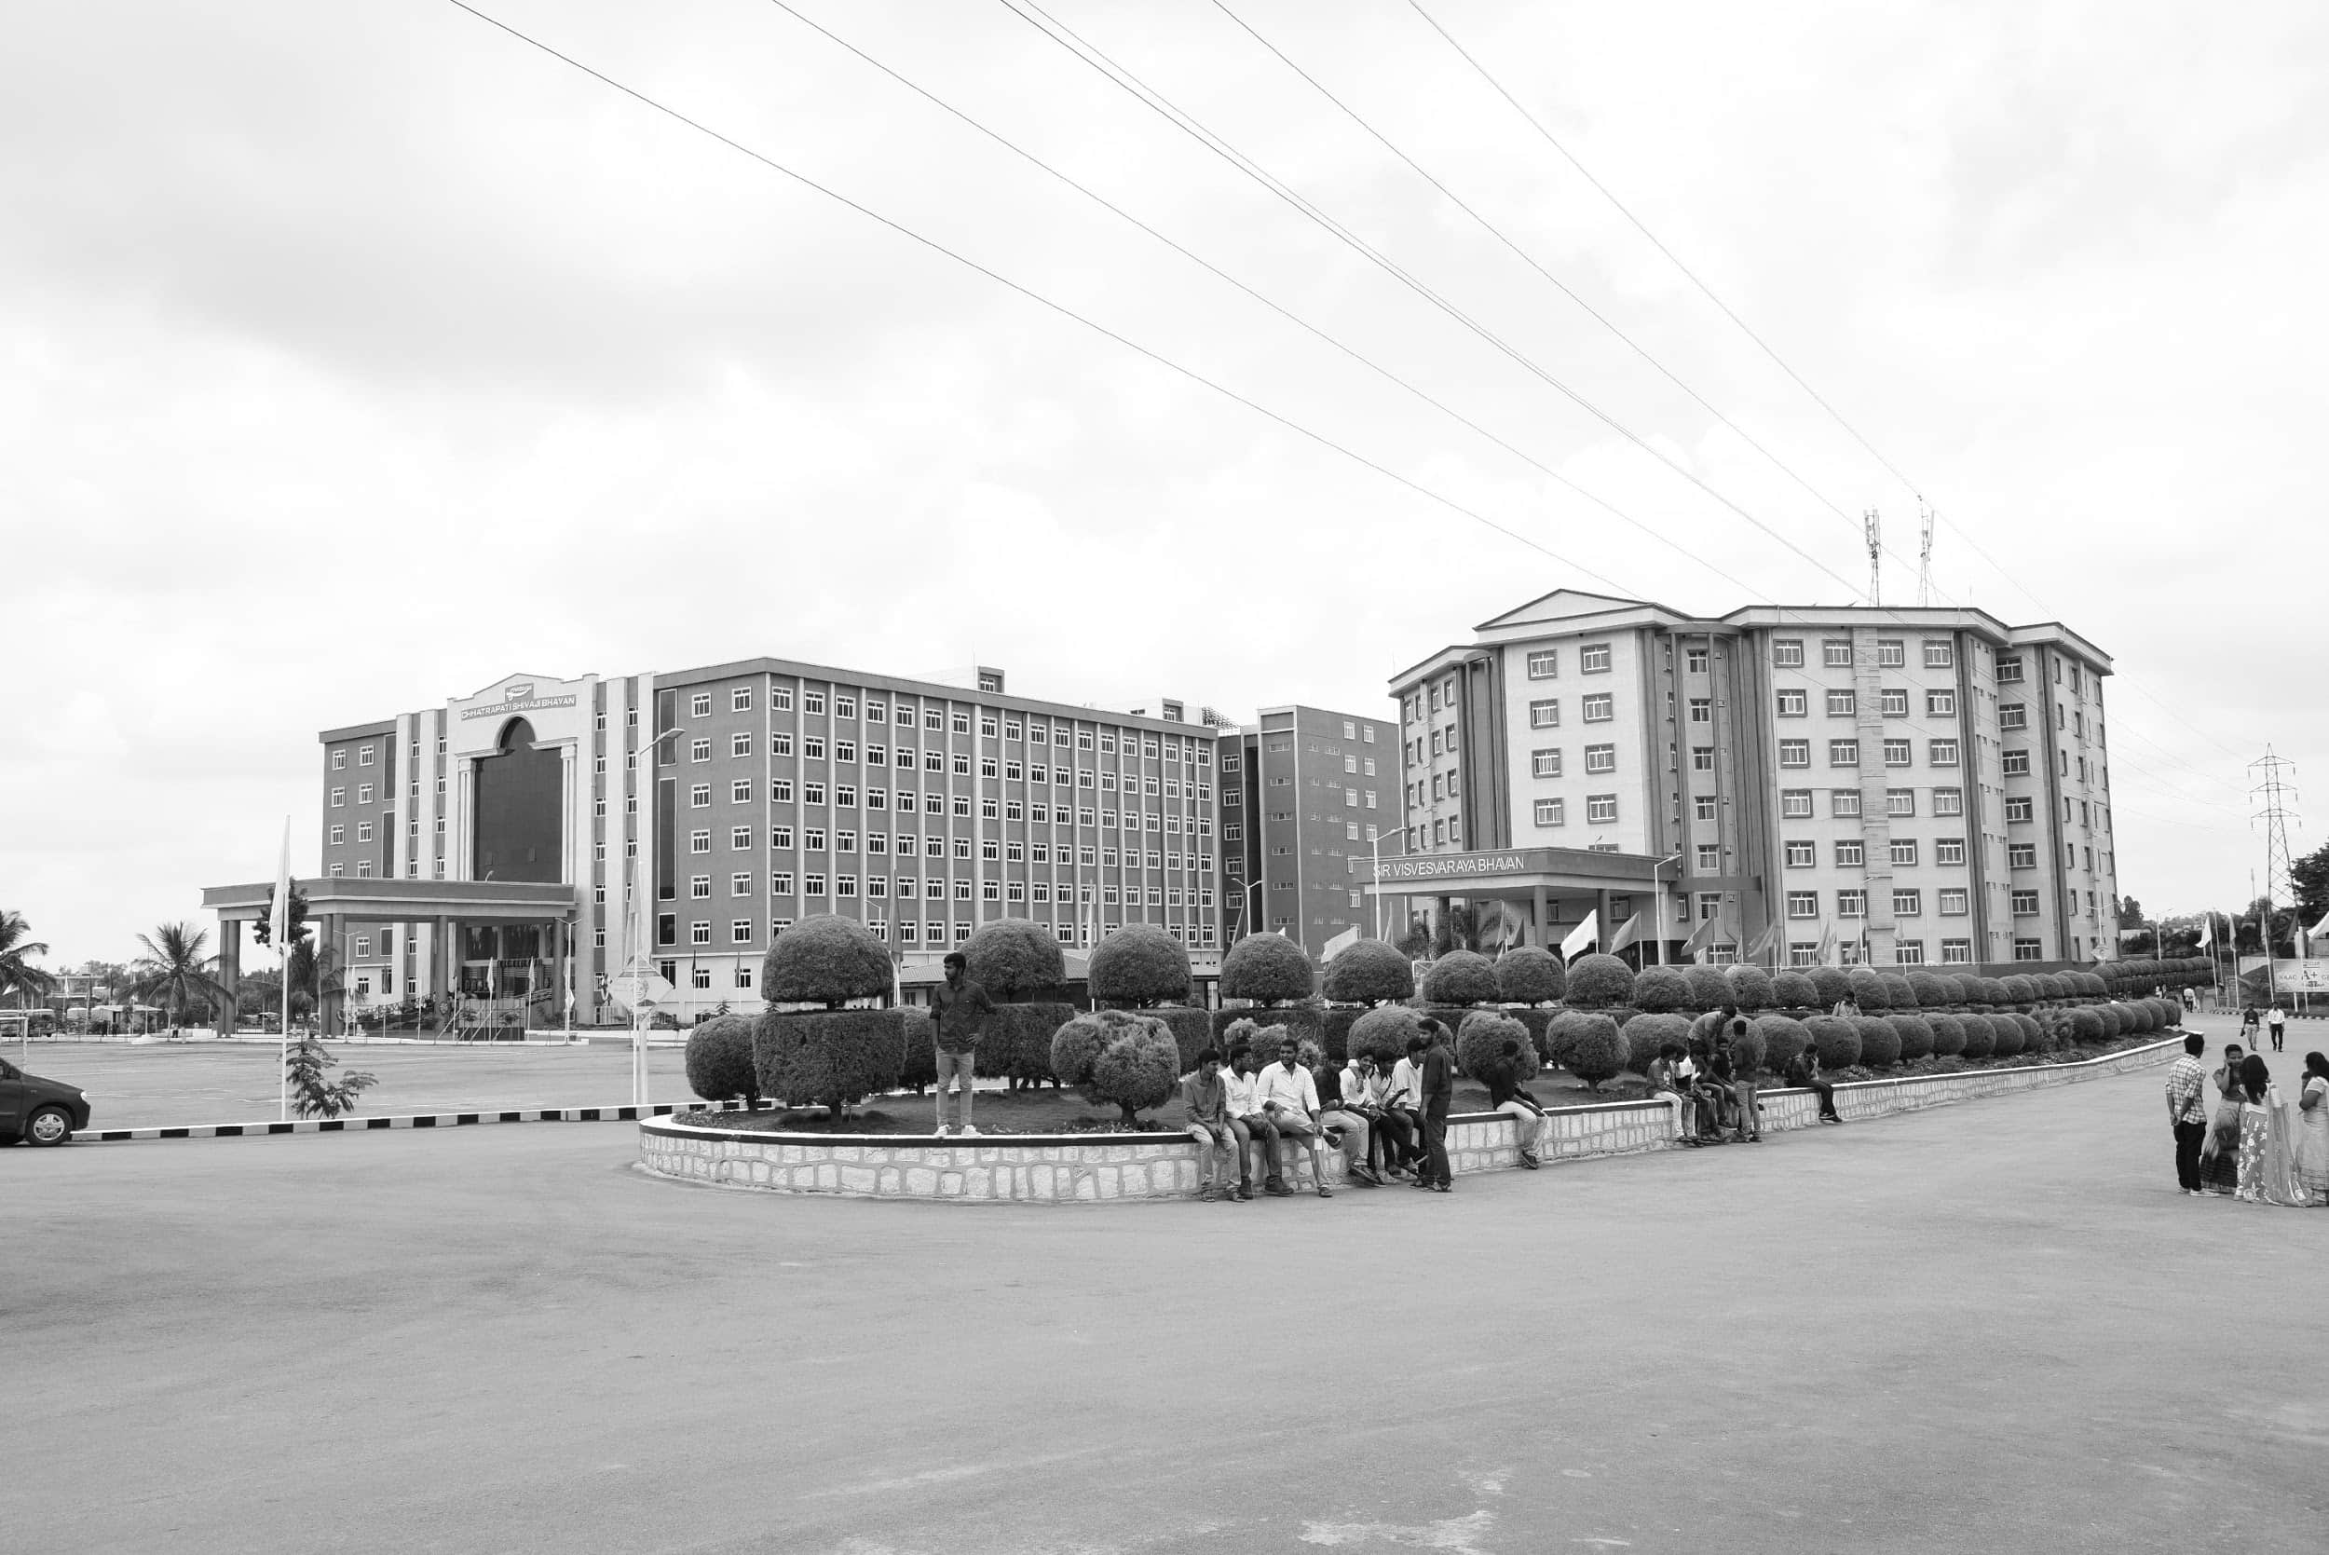



Internship Presentation – Intel Unnati Program
NAVYASHREE J
Roll Number: BU22EECE0100455
Electronics and Communication Engineering, 4th Year
Internship Duration: May 15 – July 5
Organization: Intel Unnati | GITAM University Bengaluru

Slide 2
Intel Unnati is an online project-based internship that happens every summer. Through out the internship the company mentor and college mentor have helped us by providing softwares.

Slide 3
Objectives of the Internship
1
2
3
Main Learning Objectives
Specific Project Objectives
Skills Expected to Gain
• Enable Natural Interaction: Create an assistant that can communicate with students via text and voice, mimicking natural conversation.
• Process Educational Visual Data: Showcase the assistant's adaptability by adding the ability to upload images for analysis of visual content.
• Prepare for Future Integration: Design components with flexibility to integrate future technologies like OpenVINO™ for acceleration or classroom hardware systems
• Include Speech Recognition and Synthesis: Make voice communication accessible by utilizing text-to-speech and speech-to-text capabilities.
• Incorporate Emotion Recognition: Use facial expressions to identify students' emotions to tailor feedback and assess understanding.
• Construct a Modular Flask Application: Create RESTful endpoints to manage a range of functions, such as image processing, voice queries, emotion analysis, and Q&A.
Artificial Intelligence
Machine learning
HTML
Advanced Python
Website creation

Slide 4
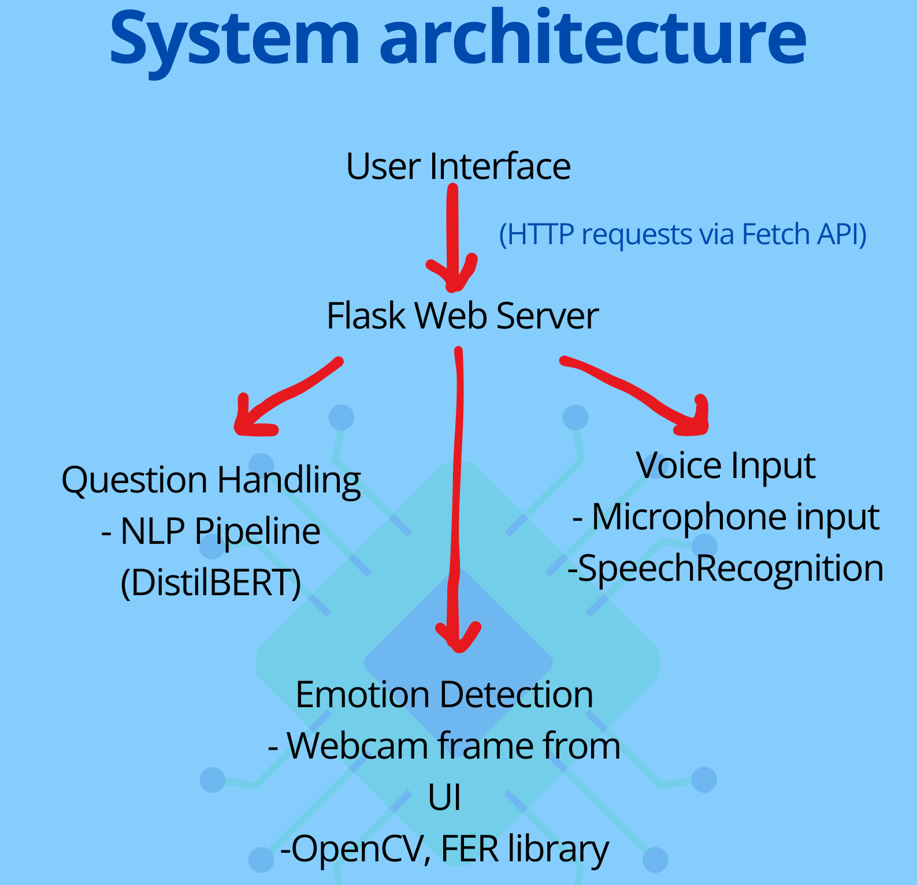
Roles & Responsibilities
Role
Responsibilities
My role was to Develop the Python Code and learn to work with OpenVINO. I was tasked to create a website using Flask.
Download the OpenVINO software.
Write the Python codes and check with the team.
Run it on the command prompt every day to check for its smooth operation.
Flask application development
Implementing voice interaction.
Conduct weekly meetings with the team.
Tools & Technologies
Python 3.x
Flask
Transformers with Hugging Faces
Speech Recognition
System.Speech.Synthesis
FER (Facial Emotion Recognition)
Pillow
NumPy
JavaScript, HTML, and CSS

Slide 5
Problem Statement & Approach
Problem Statement
Teachers face significant limitations in understanding real-time student focus during lectures. In the context of large online or hybrid classes, it becomes virtually impossible to manually track the engagement level of each individual student, leading to reduced learning effectiveness and missed opportunities for intervention.
1. NLP Module (/ask endpoint):
▪ Responses are generated from a static educational context about Artificial Intelligence.
2. Voice Processing (/voice endpoint):
▪ Captures voice input via microphone using speech recognition.
▪ Converts speech to text using Google Speech API and generates NLPbased responses.
3.Emotion Detection (/emotion endpoint):
▪ Accept webcam frames sent via POST.
▪ Decodes the image using OpenCV and applies FER () to classify emotional state.
▪ Generates context-sensitive feedback messages based on dominant emotion and confidence levels.
4.Image Analysis (/upload-image endpoint):
▪ Processes uploaded image files with Pillow (PIL) and NumPy.
▪ Converts RGB image to grayscale and returns image dimensions for basic visual analysis.

Slide 6
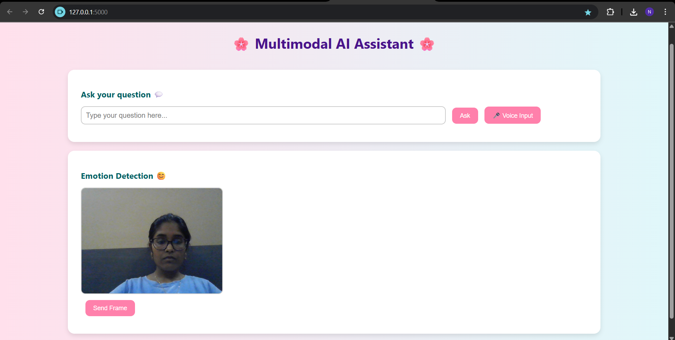
Results & Deliverables
Key Deliverables
Skills Gained
• Text & Voice Q&A: Offers immediate academic assistance via spoken and typed questions.
• Emotion-Aware Feedback: Based on the mood of the student, it provides prompts that are either supportive or corrective.
• Image Interpretation: Enables rudimentary examination of submitted images to mimic task submissions or comprehension of context
Flask framework for web application.
Natural language processing
Speech recognition and voice input using python
Computer vision techniques for web cam-based emotion detection
Project Contribution
I have worked in developing a successful website that captures my team’s vision and we have reached our goals.
Recognition
Upon successful completion of the internship, I will receive a certificate for my work. Which will add more value to my Resume.

Slide 7
Challenges Faced & Solutions
-> Accuracy Challenge: Ensuring AI answers were correct and contextually appropriate. Solution: Used pre-trained NLP models (Hugging Face) and fine-tuned responses for study-related queries to improve reliability.
-> Voice Recognition Challenge: Difficulty understanding accents and handling noisy environments. Solution: Integrated robust speech recognition libraries and applied noise reduction techniques to enhance clarity.
->Hardware Issues Challenge: Limited device performance affected speed and real-time processing. Solution: Optimized models with OpenVINO for CPU-based inference to reduce computational load.
->Server Management Issues Challenge: Local server sometimes crashed or ran slowly. Solution: Implemented error handling, used lightweight Flask framework, and structured routes efficiently.
-> Face Recognition Challenge: Hard to recognize accurately due to poor lighting, environment, or low camera quality. Solution: Applied preprocessing (grayscale conversion, resizing) and optimized the emotion detection model for better robustness.

Slide 8
Conclusion
We have built an intelligent classroom assistant capable of understanding and responding through text, voice, and visual inputs.
It offers personalized, support to students if enhanced, enriching the learning experience and promoting active engagement.
Key modules—such as question answering, speech interaction, and basic visual processing—are already operational.
Our next steps involve introducing engagement detection, refining the user interface, and optimizing performance using model acceleration techniques.

Slide 9
Future Work & Career Relevance
Github link
https://github.com/navyashree1710/OpenVino_Assistant
Immediate Vision : Visuals Aids for better understanding
Long-Term Vision
Introduce Visual Question Answering (VQA): Enable the system to answer questions about images (e.g., diagrams, graphs, science visuals).
LMS Integration: Seamlessly connect with platforms like Moodle, Google Classroom, or Canvas for full academic workflow support.
Personalized AI Learning: Incorporate memory so the assistant remembers user behavior, topics of interest, and learning history.
Code Used (app.py) https://drive.google.com/file/d/1ecl1UiOTfq6cqBFVoss2ZEkGjswf2lAK/view
Code Used (index.html)
https://drive.google.com/file/d/122mEBqEtoAF4FND6RqTGuk3-vvnfmeAA/view

